Slide 1
VINE’S PRODUCT GUIDE
VINESARTISANBAKERY.CO.UK

Slide 2
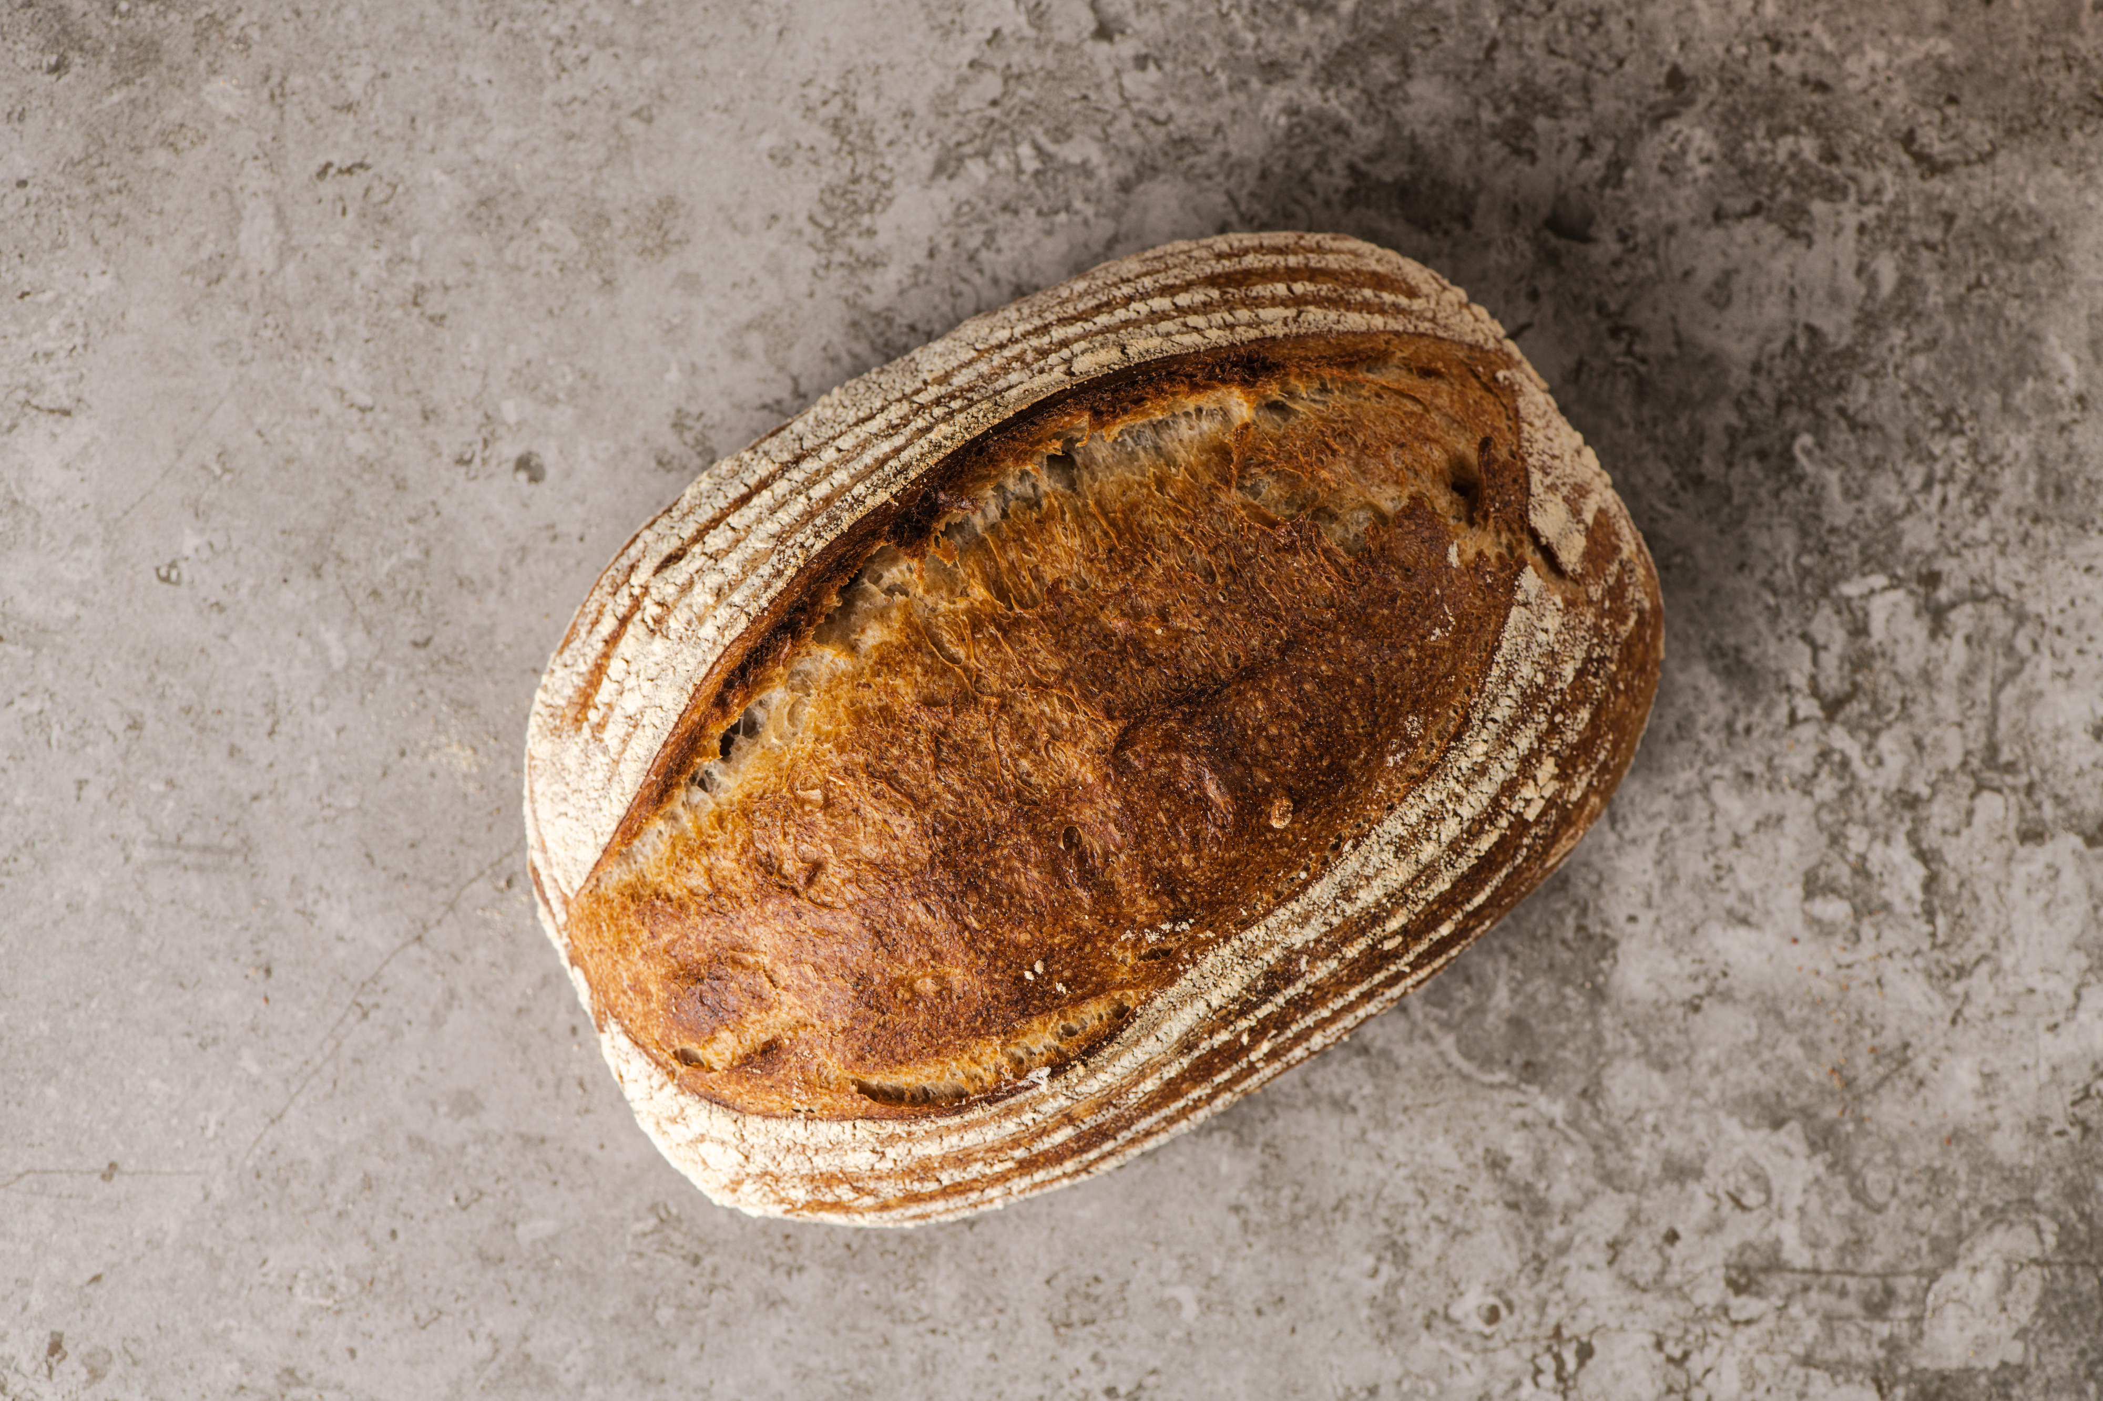
CLASSIC SOURDOUGH
THE VINE’S CLASSIC LOAF, 3 DAYS IN THE MAKING. JUST FLOUR, WATER AND SALT. IT’S CRUSTY AND HEARTY WITH A MILD TO MEDIUM SOUR FLAVOUR AND A WAXY OPEN CRUMB. BEAUTIFUL FRESH AND TOASTS FOR DAYS. 10% WHOLEMEAL GRAIN.
ALLERGENS | MAIN: Gluten (wheat and rye) TRACE: sesame, egg, milk, tree nuts, oats, sulphites, soya

Slide 3
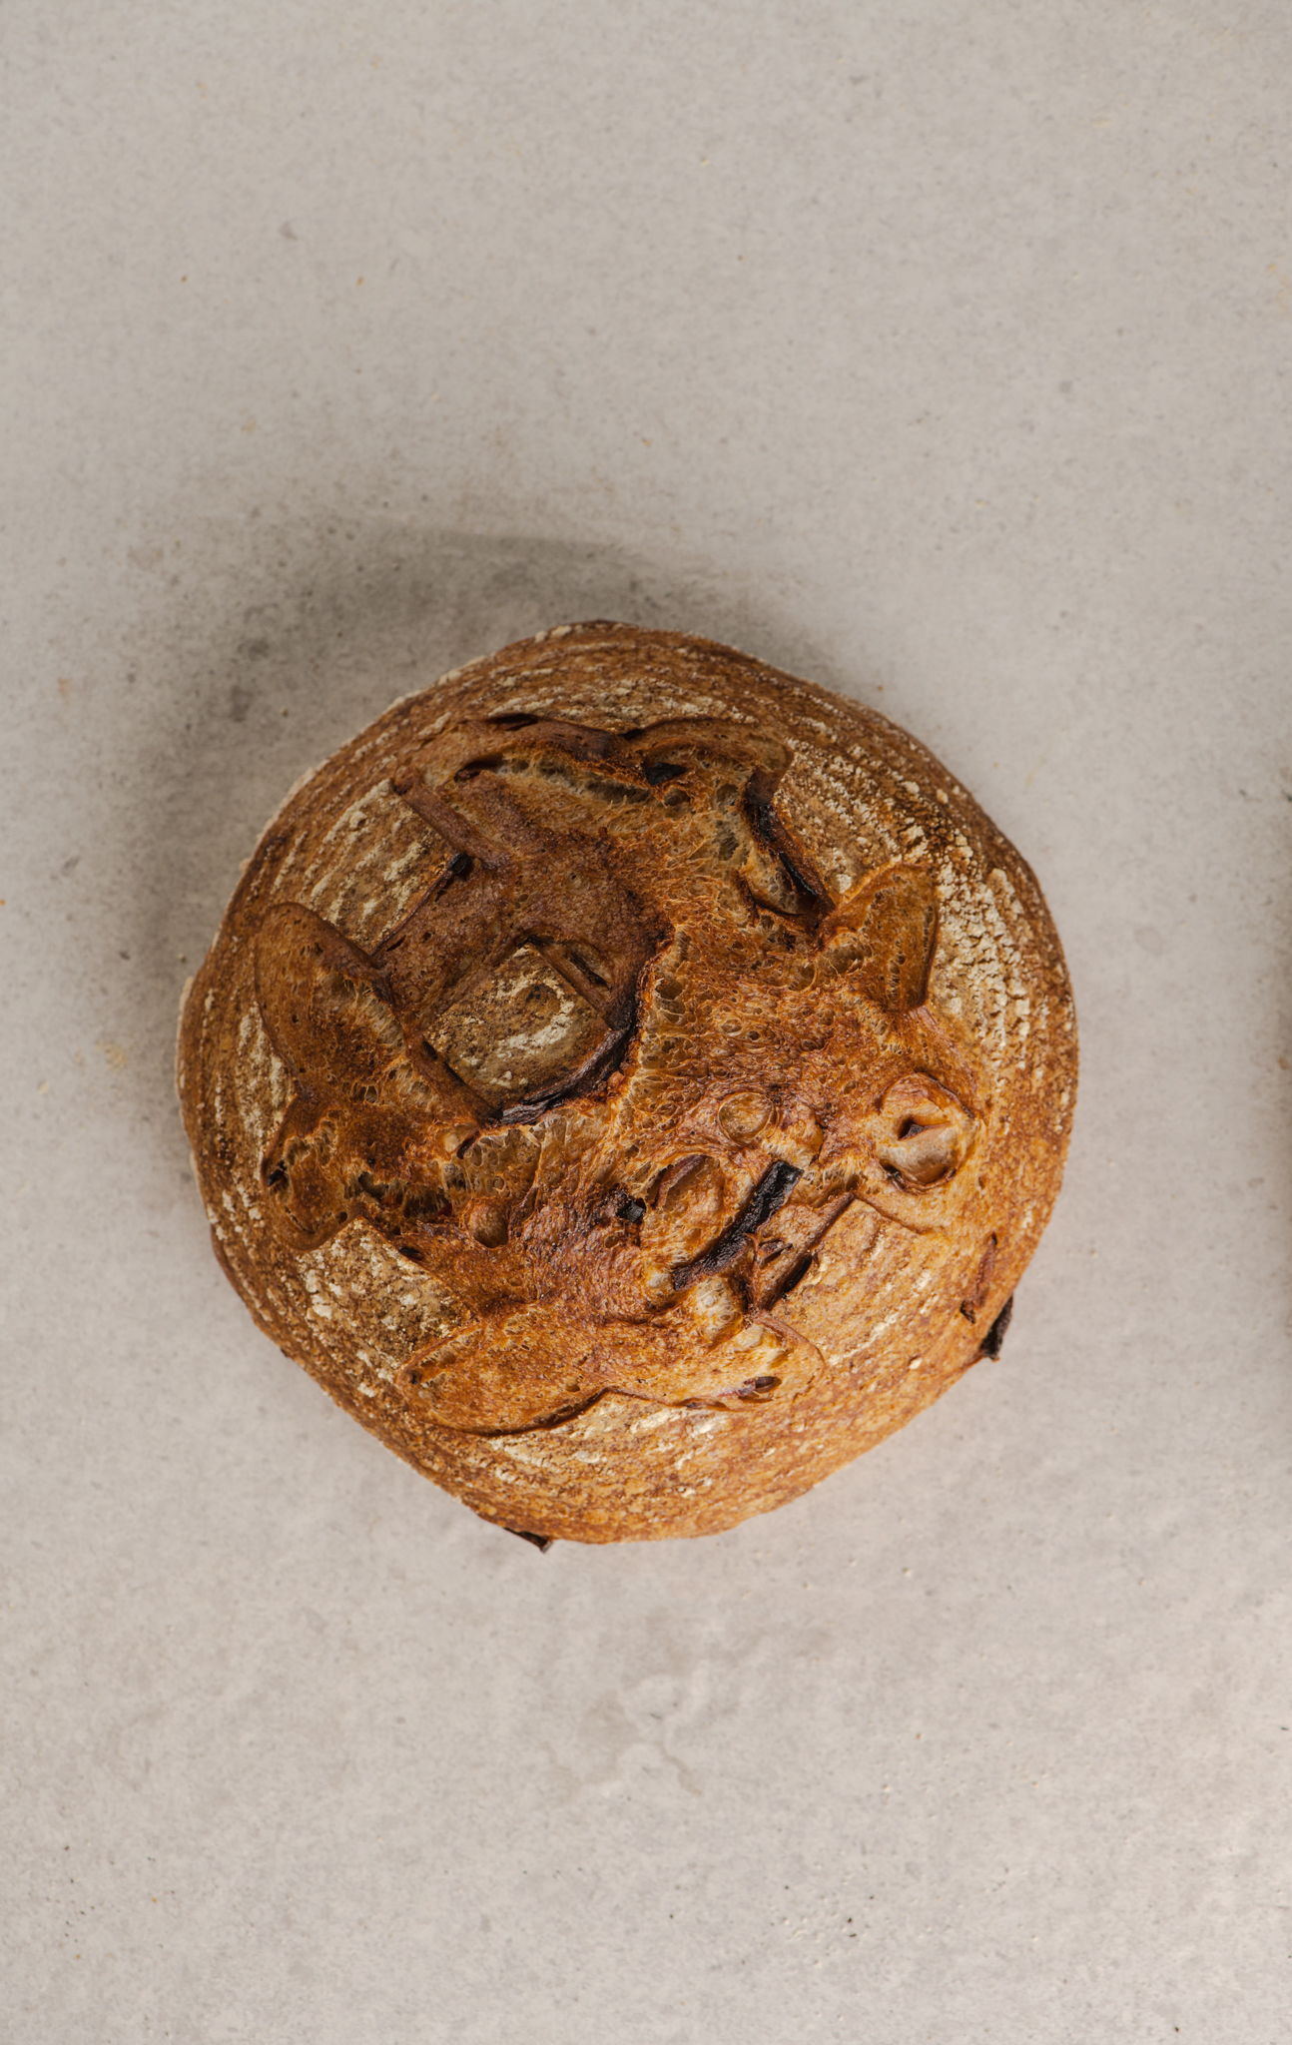
FLAVOURED SOURDOUGH
HOUSE SOURDOUGH WITH ADDITIONS
SEASONAL OR BAKER’S CHOICE FLAVOURS
ASK US WHAT’S ON- OR MAKE A SUGGESTION!
Rosemary & Raisin, Caramelised Onion & Herb, Spiced Apple, Red Onion & Chilli, Toasted Linseed & Sunflower
ALLERGENS | MAIN: Gluten (wheat and rye) TRACE: sesame, egg, milk, tree nuts, oats, sulphites, soya (Plus additional ingredients for respective flavours, enquire with staff)

Slide 4
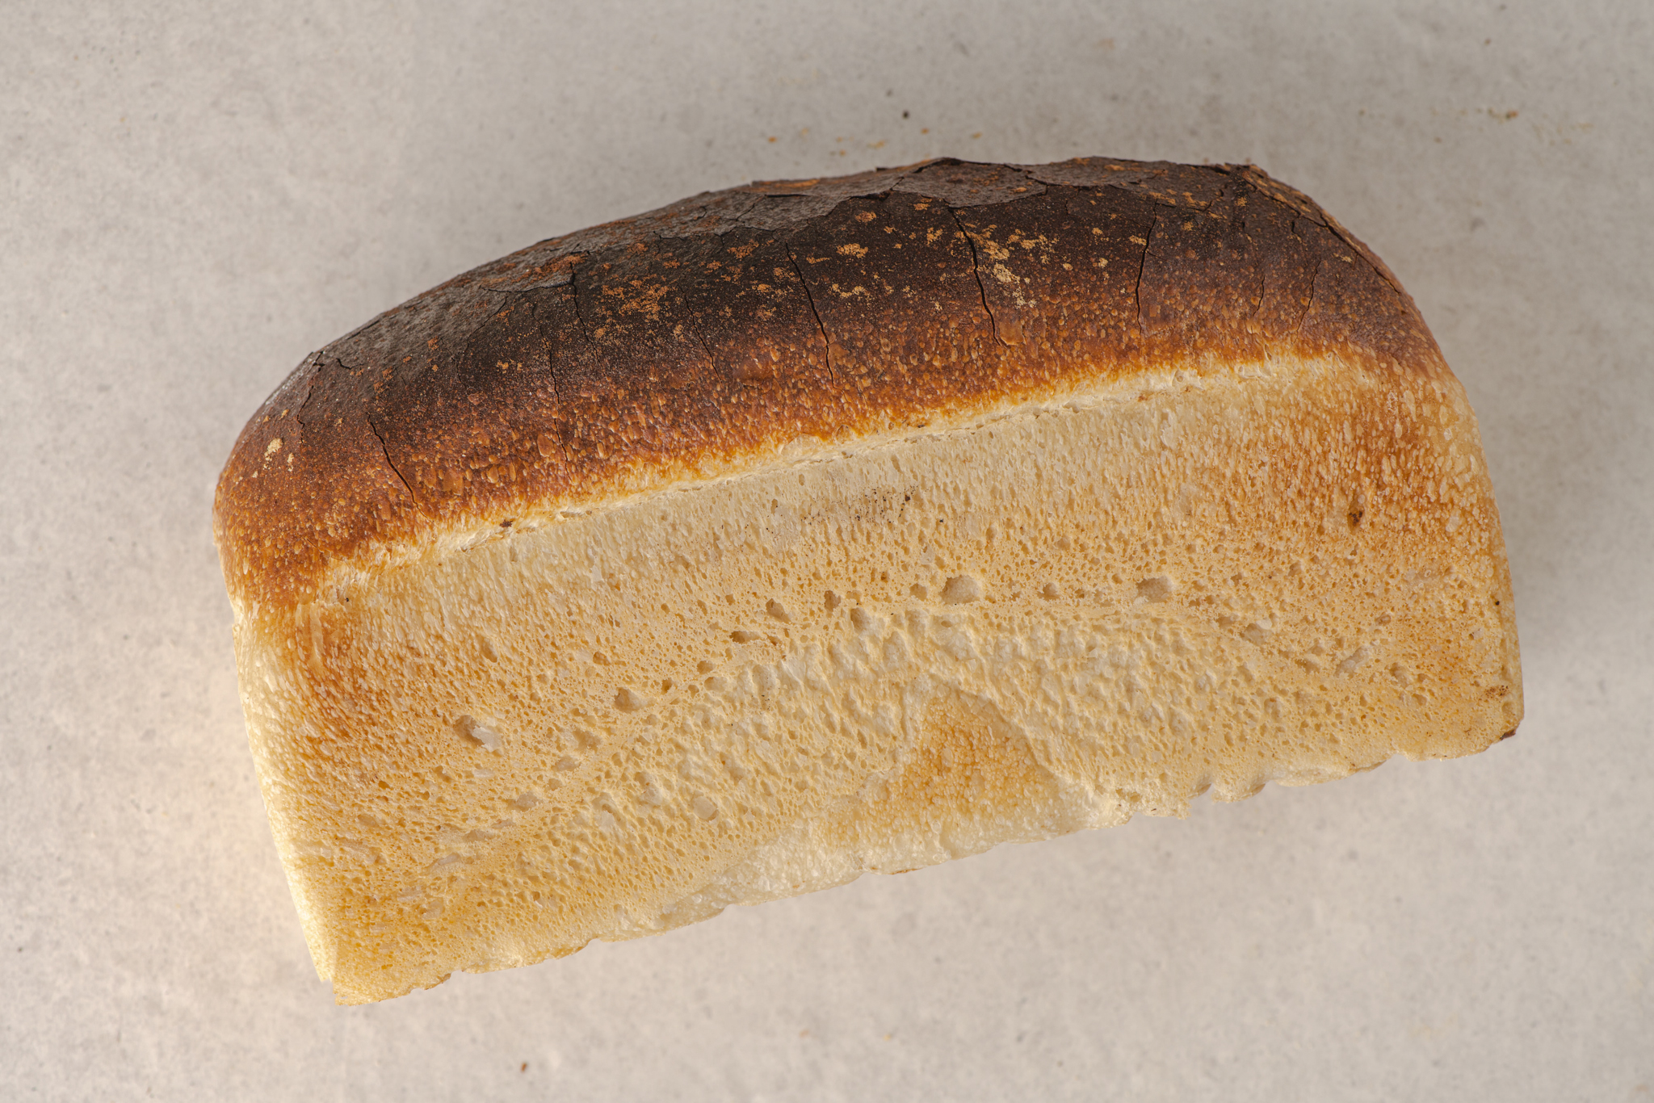
WHITE TIN LOAF
TRADITIONAL SOFT WHITE BREAD, PERFECT FOR SANDWICHES AND TOASTIES. A MORE ROBUST SLICE THAT ITS SUPERMARKET RIVALS, IT’S VEGAN, ADDITIVE FREE AND EASIER ON YOUR DIGESTIVE SYSTEM.
ALLERGENS | MAIN: Gluten (wheat and rye) TRACE: sesame, egg, milk, tree nuts, oats, sulphites, soya

Slide 5
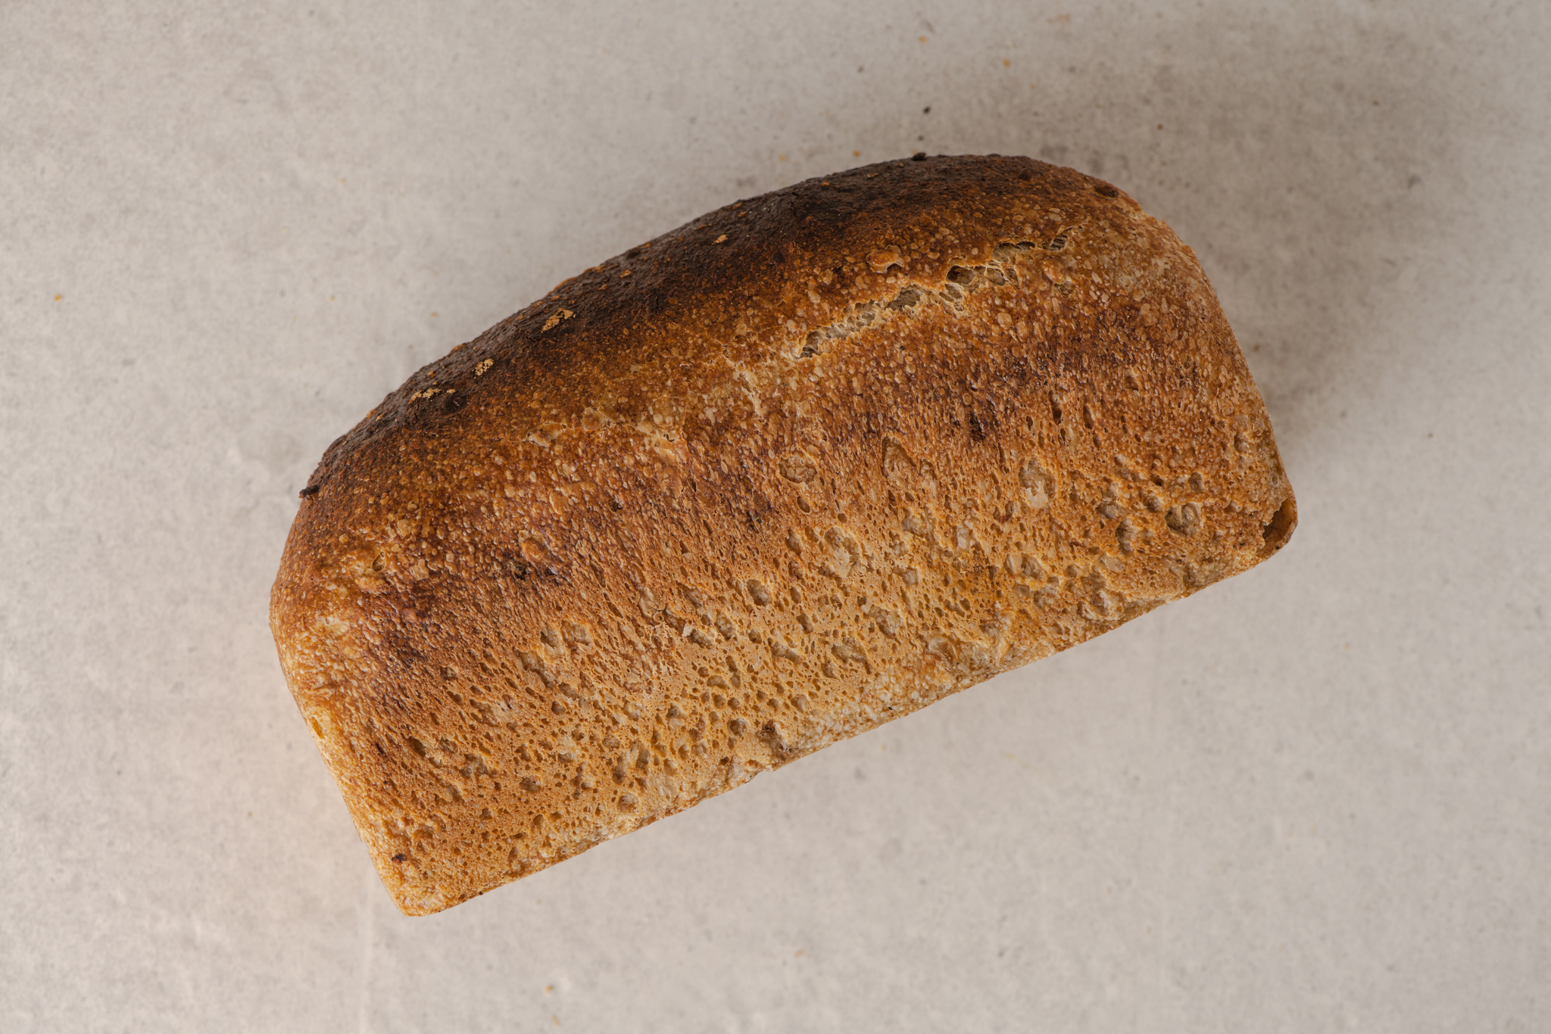
MALTED TIN LOAF
OUR GRANARY STYLE TIN LOAF, PART WHOLEMEAL. WITH A CLOSE AND DELICATE CRUMB. MALTED WHEAT FLAKES AND SPENT BREWERS GRAIN BRING EXTRA FLAVOURS AND TEXTURES. PERFECT FOR SANDWICHES AND TOASTIES. IT’S VEGAN, ADDITIVE FREE AND EASIER ON YOUR DIGESTIVE SYSTEM.
ALLERGENS | MAIN: Gluten (wheat and rye) TRACE: sesame, egg, milk, tree nuts, oats, sulphites, soya

Slide 6
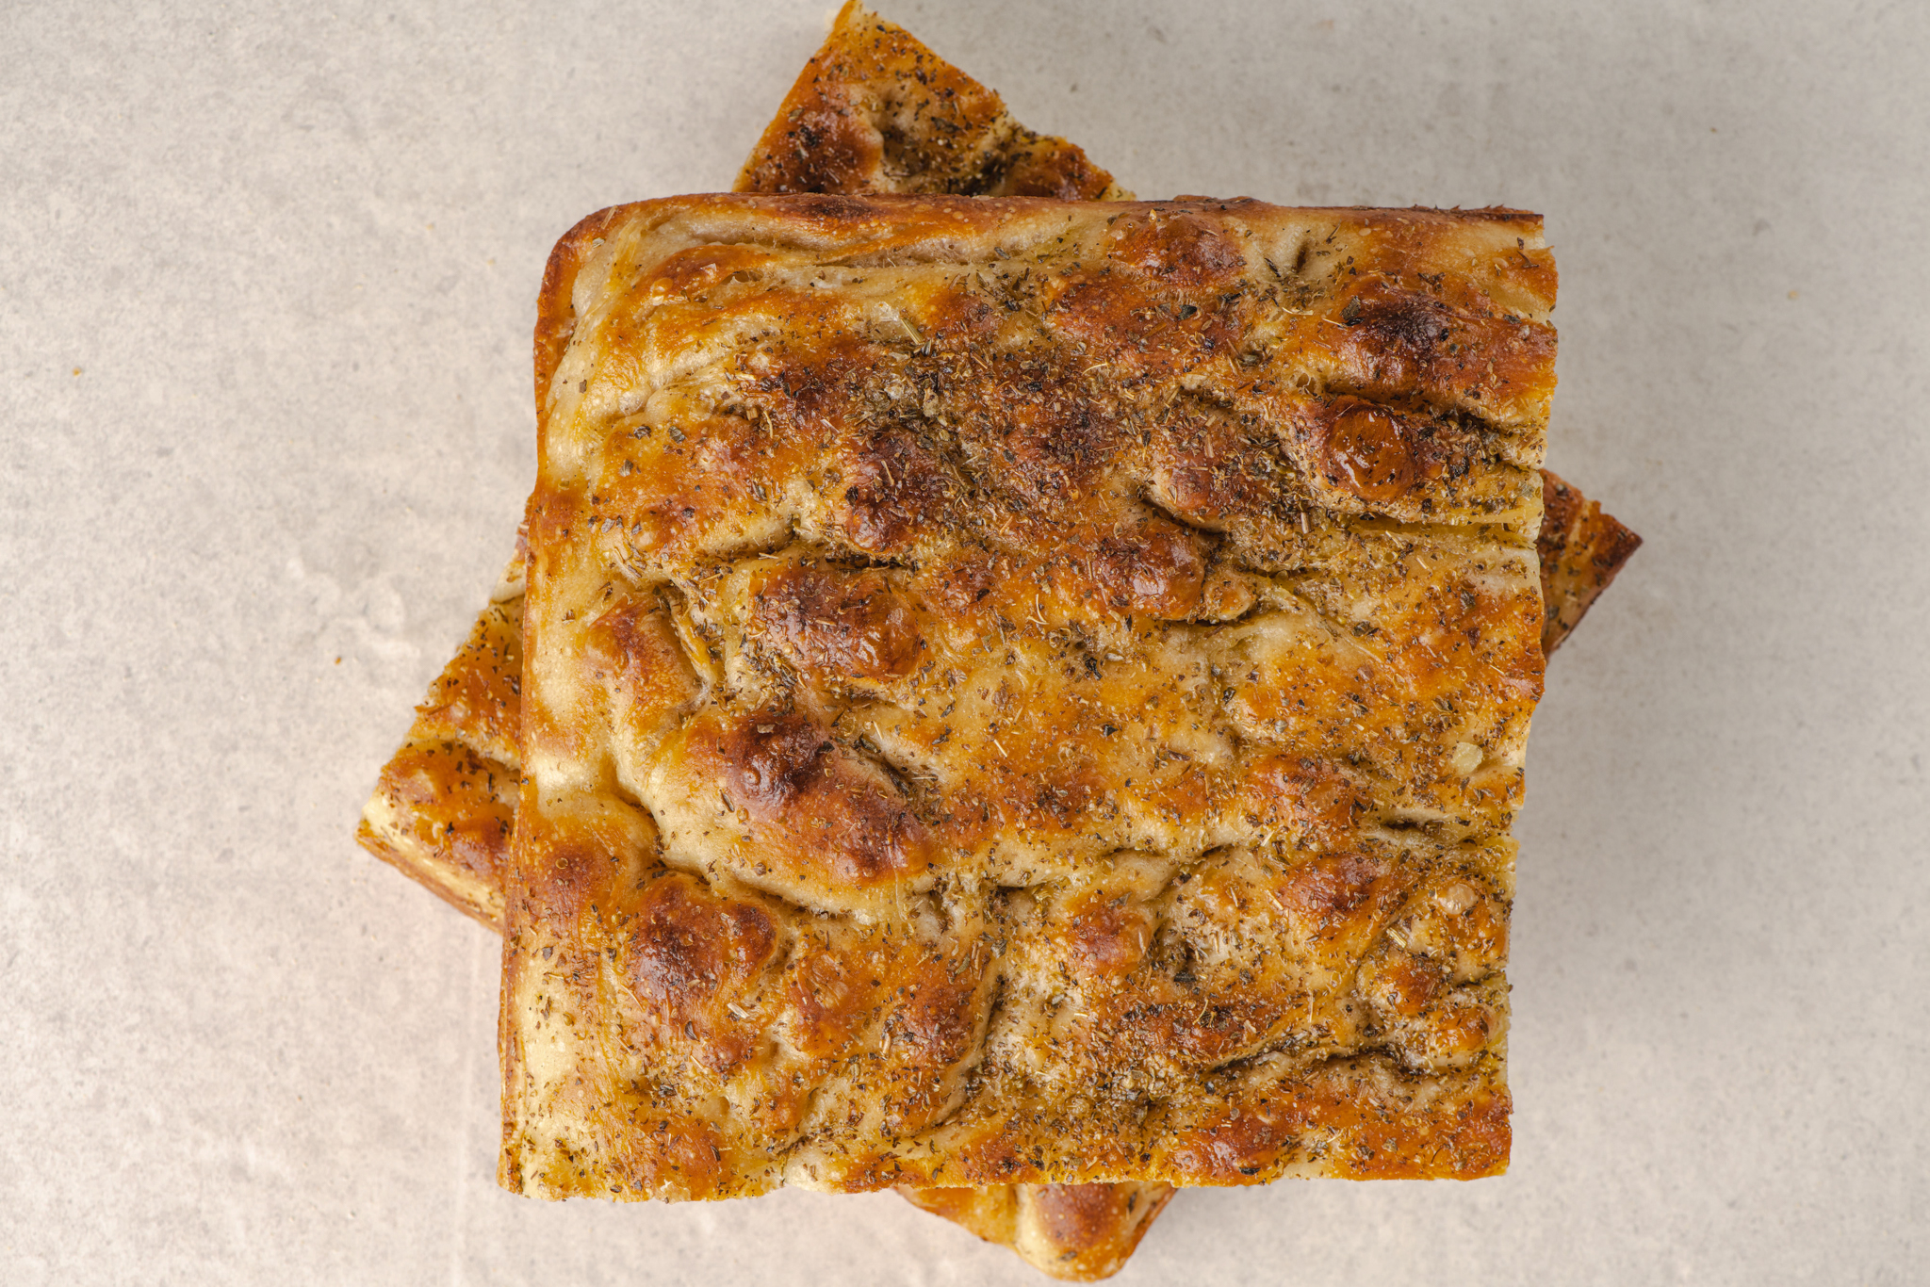
HERB FOCACCIA
THE ITALIAN CLASSIC FLATBREAD. WITH AN OPEN WAXY TEXTURE, TOPPED WITH OREGANO AND MALDON SEA SALT, AND DROWNED IN EXTRA VIRGIN OLIVE OIL.
ALLERGENS | MAIN: Gluten (wheat) TRACE: sesame, egg, milk, tree nuts, oats, sulphites, soya

Slide 7
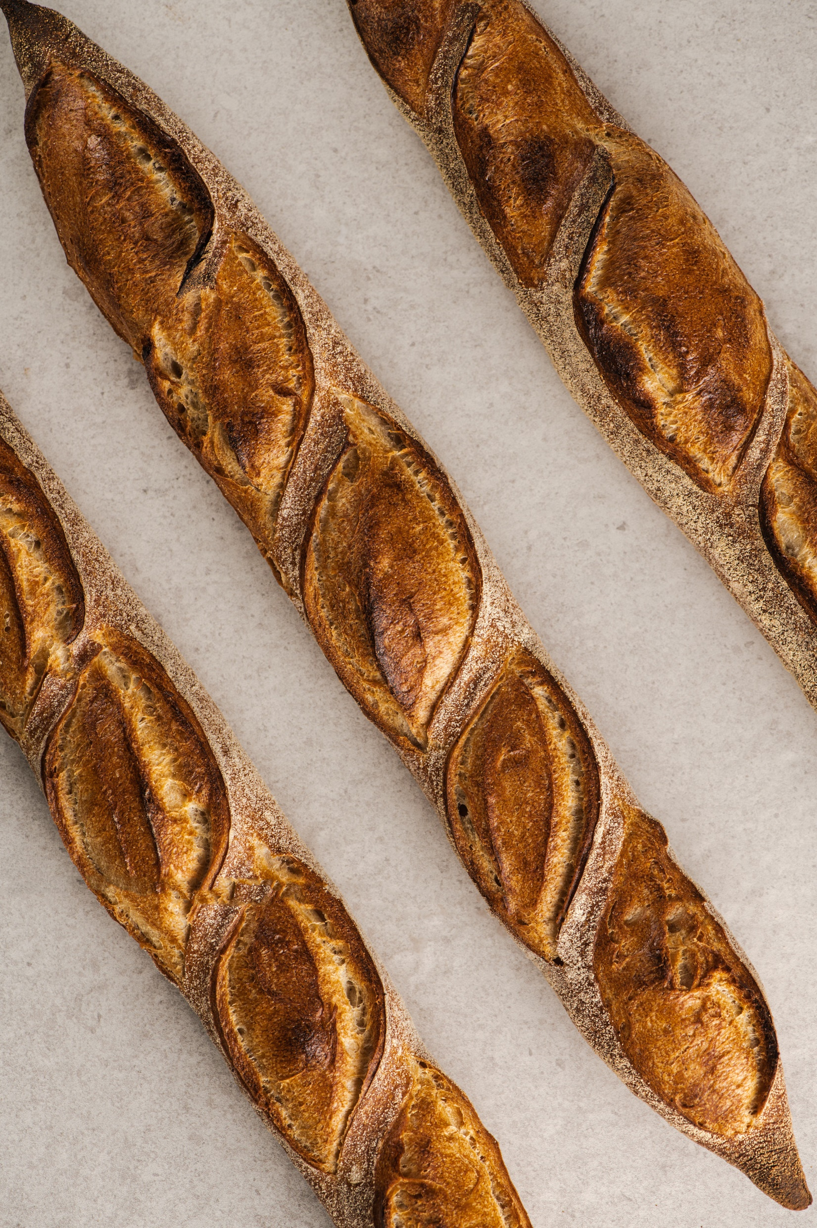
BAGUETTE
BAGUETTE DE TRADITION. A CLASSIC FOR A REASON. LOTS OF CRUST WITH AN OPEN, CHEWY TEXTURE AND MILD SOUR NOTES.
ALLERGENS | MAIN: Gluten (wheat) TRACE: sesame, egg, milk, tree nuts, oats, sulphites, soya

Slide 8
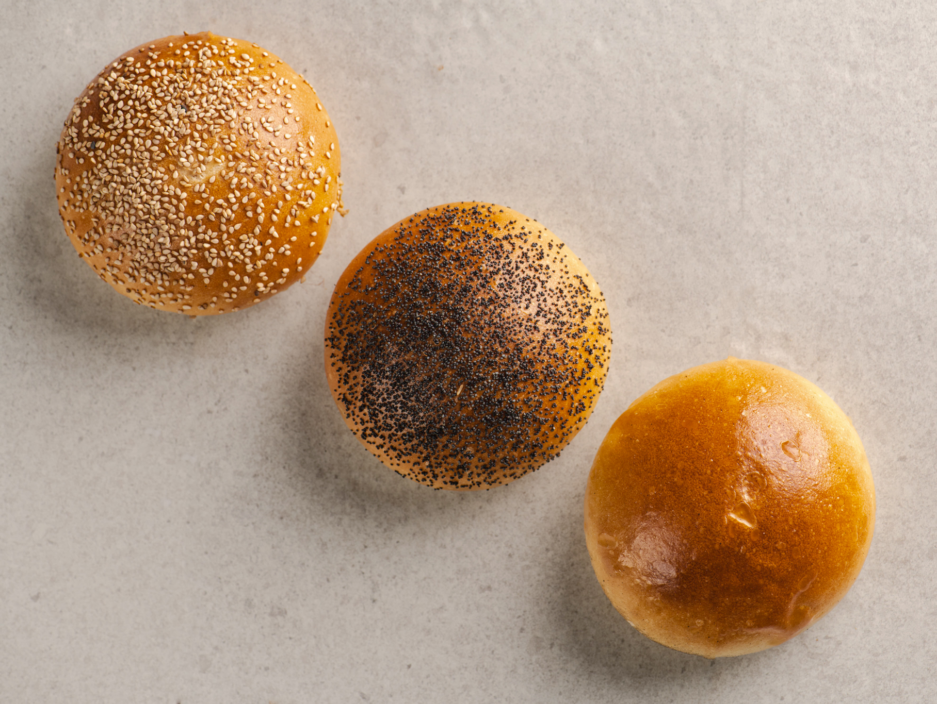
MILK BURGER BUN
THE PERFECT VESSEL FOR A BURGER, OR ANY OTHER SANDWICH FILLING FOR THAT MATTER. THEY’RE SOFT YET ROBUST, FULL OF FLAVOUR WITH A SUBTLE SWEETNESS. EGG WASHED AND FINISHED PLAIN OR WITH SEEDS.
ALLERGENS | MAIN: Gluten (wheat), milk, egg, sesame or poppy (if seeded) TRACE: sesame, egg, milk, tree nuts, oats, sulphites, soya

Slide 9
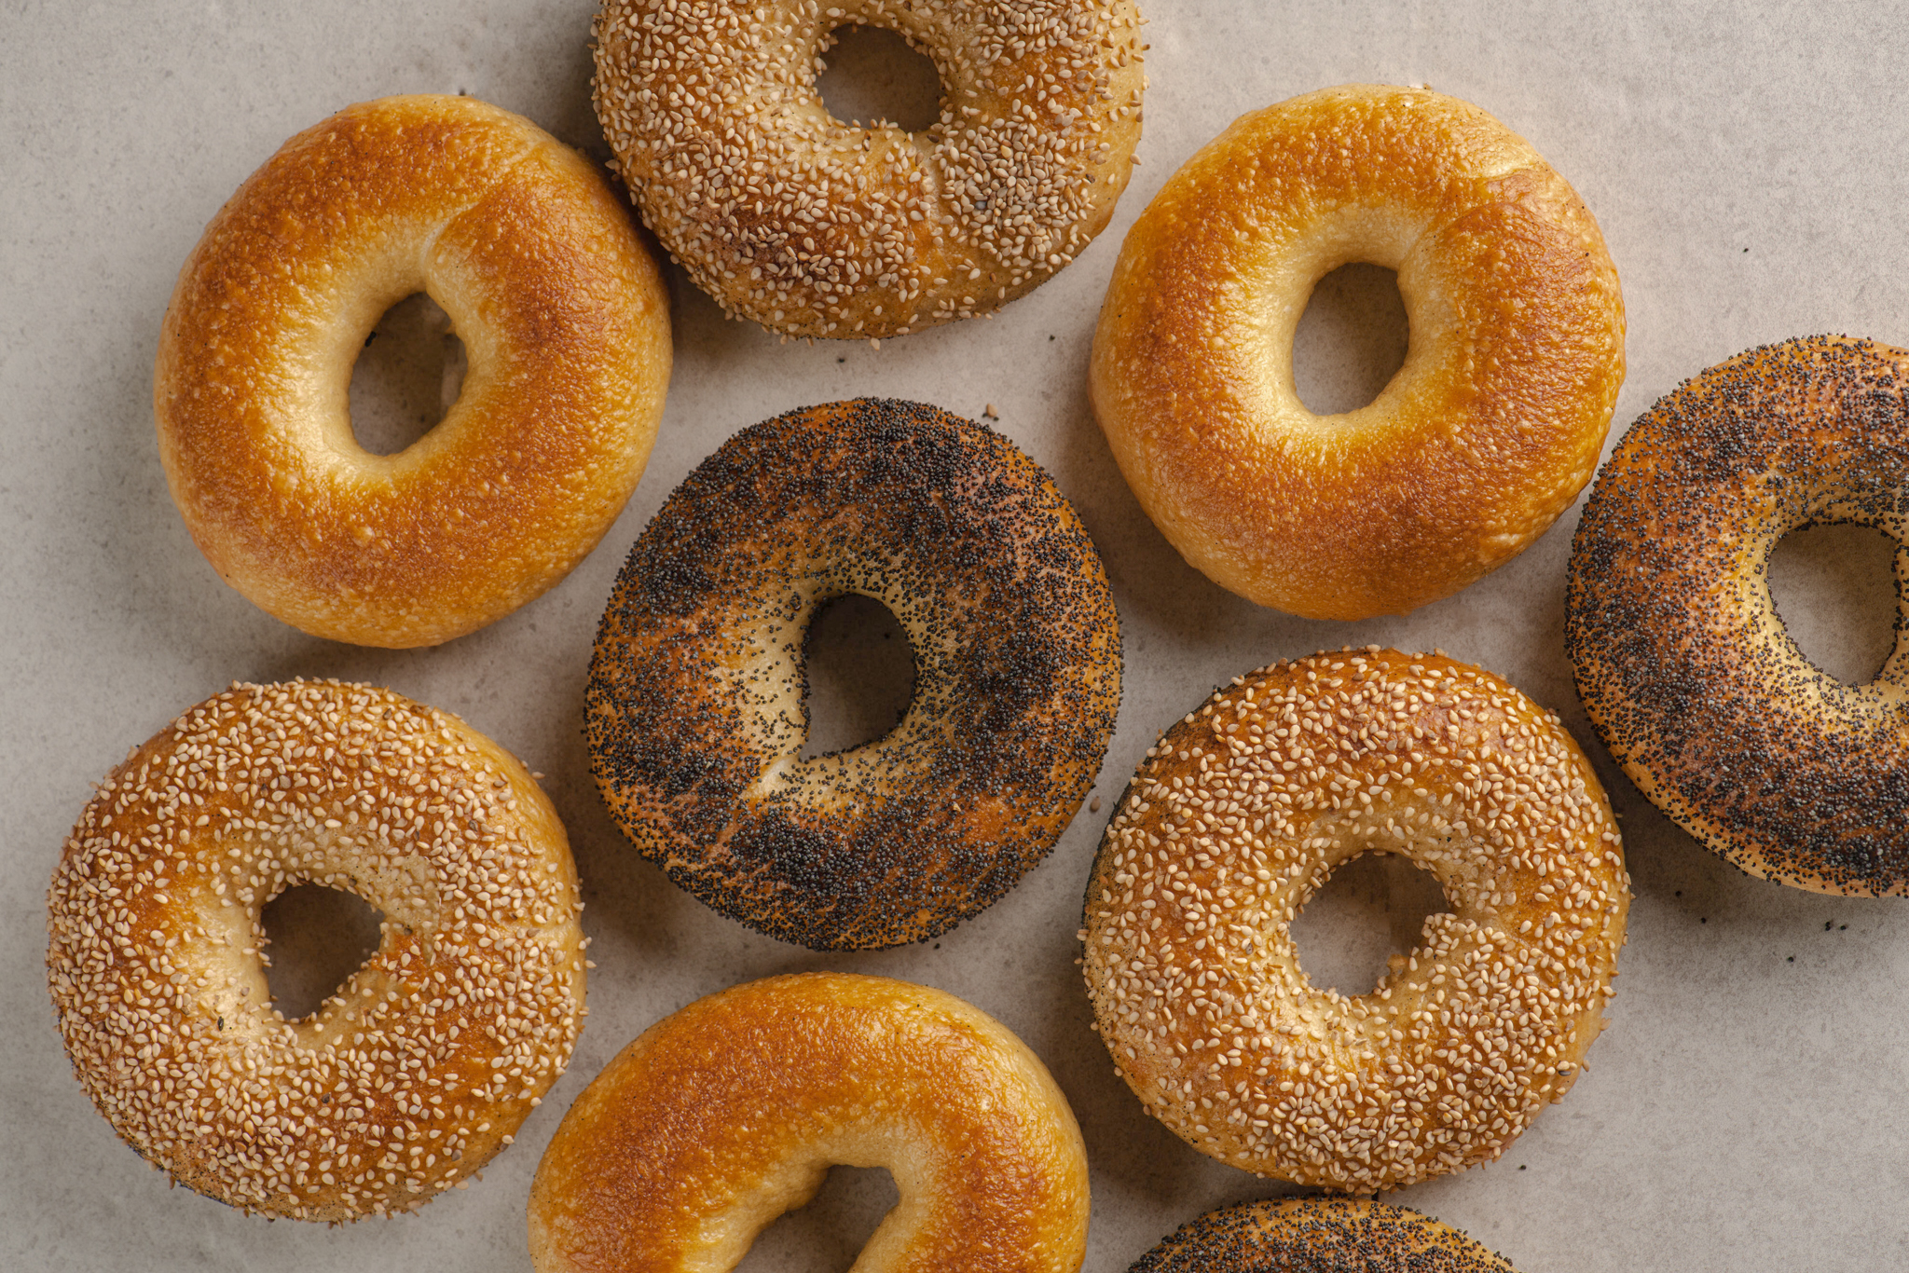
CLASSIC BAGEL
DENSE AND CHEWY LIKE A BAGEL SHOULD BE. POACHED IN A SWEET TREACLY BATH BEFORE BAKING. FINISHED WITH POPPY SEEDS, SESAME SEEDS OR PLAIN.
ALLERGENS | MAIN: Gluten (wheat, barley), sesame or poppy (if seeded) TRACE: sesame, egg, milk, tree nuts, oats, sulphites, soya

Slide 10
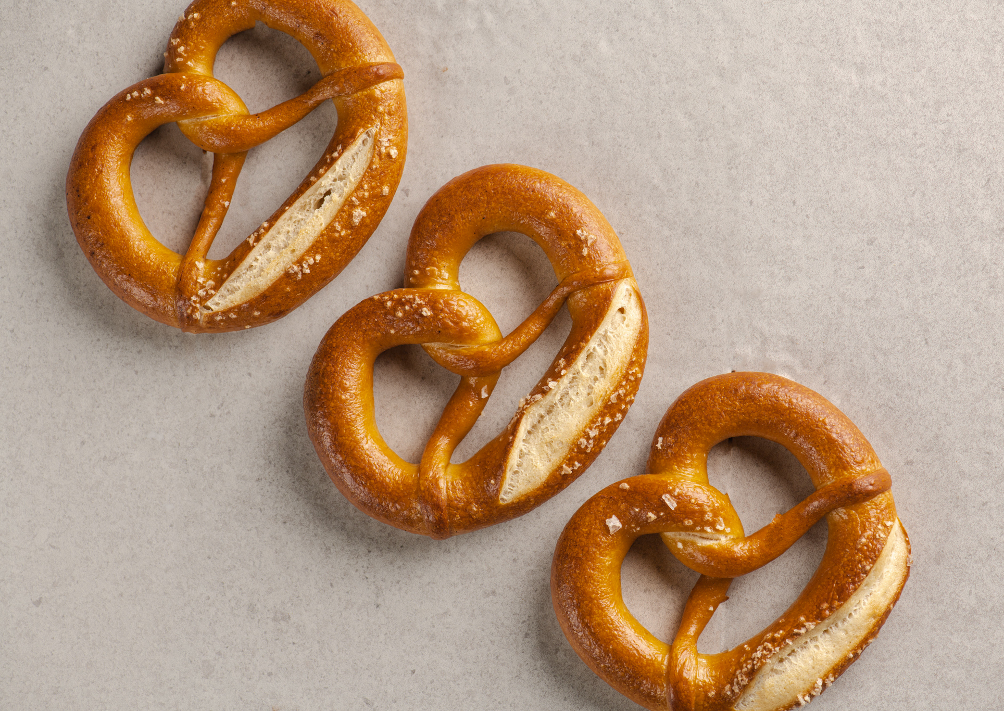
SALTED PRETZEL
TRADITIONAL, SOFT, LYE DIPPED PRETZEL. A THIN, SHINY CRUST AND DENSE, CHEWY TEXTURE. SCATTERED WITH MALDON SEA SALT. LIMITED AVAILABILITY SO GRAB ONE QUICK!
ALLERGENS | MAIN: Gluten (wheat), milk TRACE: sesame, egg, milk, tree nuts, oats, sulphites, soya

Slide 11
BUTTER CROISSANT
VIENNOISERIE ROYALTY. FLAKEY, BUTTERY, SWEET OR SAVOURY, BREAKFAST OR LUNCH. MADE WITH WILD FARMED REGENERATIVE WHEAT, AND TOP QUALITY FRENCH PATISSERIE BUTTER – TRULY AUTHENTIC FRENCH PASTRY.
ALLERGENS | MAIN: Gluten (wheat), egg, milk TRACE: sesame, egg, milk, tree nuts, oats, sulphites, soya

Slide 12
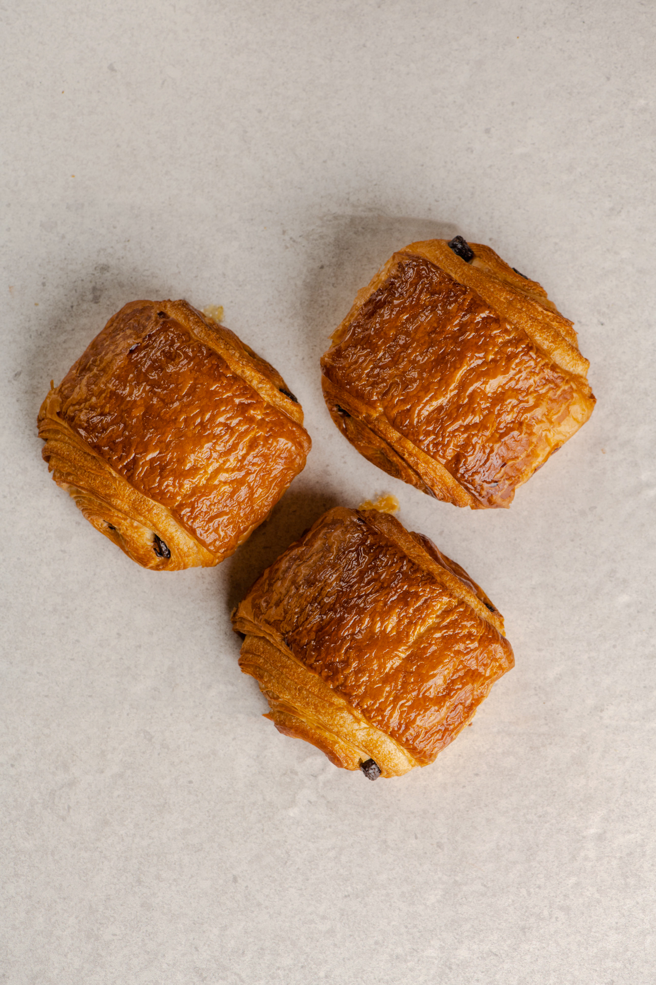
PAIN AU CHOCOLAT
ITS OUR CLASSIC CROISSANT DOUGH MADE USING WILDFARMED FLOUR AND FRENCH PATISSERIE BUTTER, WITH ADDED VALRHONA CHOCOLATE – WHAT’S NOT TO LOVE?
ALLERGENS | MAIN: Gluten (wheat), egg, milk TRACE: sesame, egg, milk, tree nuts, oats, sulphites, soya

Slide 13
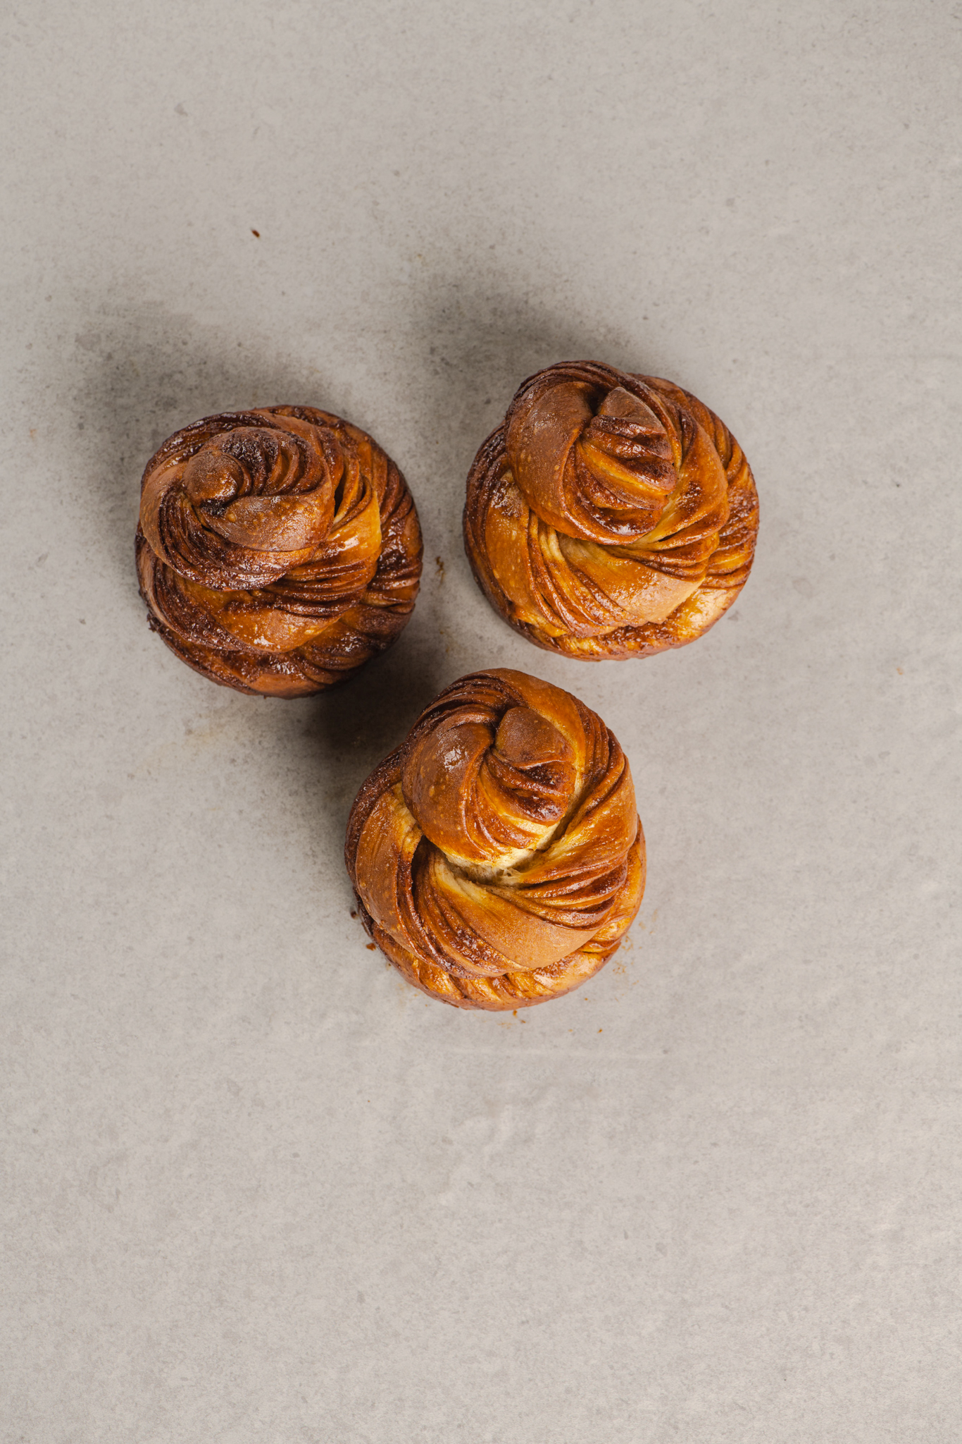
SWEET BRIOCHE KNOTS
TENDER, RICH BRIOCHE DOUGH WITH CHOCOLATE, CINNAMON, OR CARDAMOM BUTTER AND VANILLA SYRUP. THE PERFECT BREAKFAST.
ALLERGENS | MAIN: Gluten (wheat), egg, milk, TRACE: sesame, egg, milk, tree nuts, oats, sulphites, soya

Slide 14
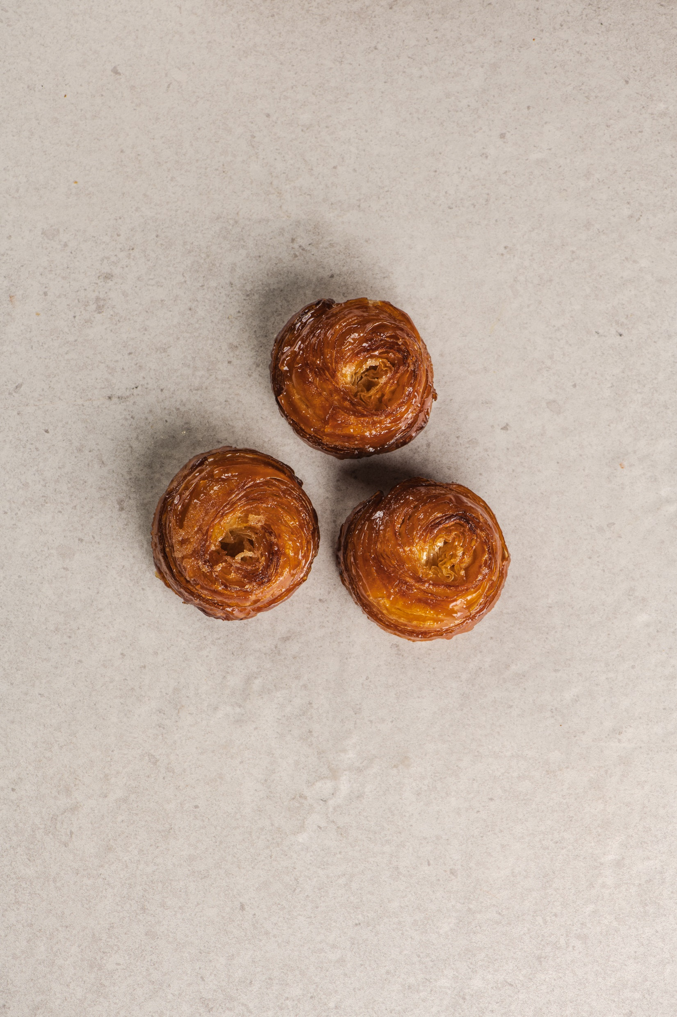
KOUIGN AMANN
THE CLASSIC PASTRY FROM BRITTANY, MADE THE VINE’S WAY. SWEET, SALTY, SOFT, CRUNCHY, CARAMELIZED BUTTERY-NESS, ALL IN ONE MOUTHFUL.
ALLERGENS | MAIN: Gluten (wheat), milk TRACE: sesame, egg, milk, tree nuts, oats, sulphites, soya

Slide 15
ANY QUESTIONS?
01522 581353
milly@vinesbakery.co.uk
Vines Bakehouse, Enterprise Park, Saxilby, Lincoln, LN1 2LR
VINESARTISANBAKERY.CO.UK

